Slide 1
James Fisher Offshore and DRI France
Partnership

Slide 2
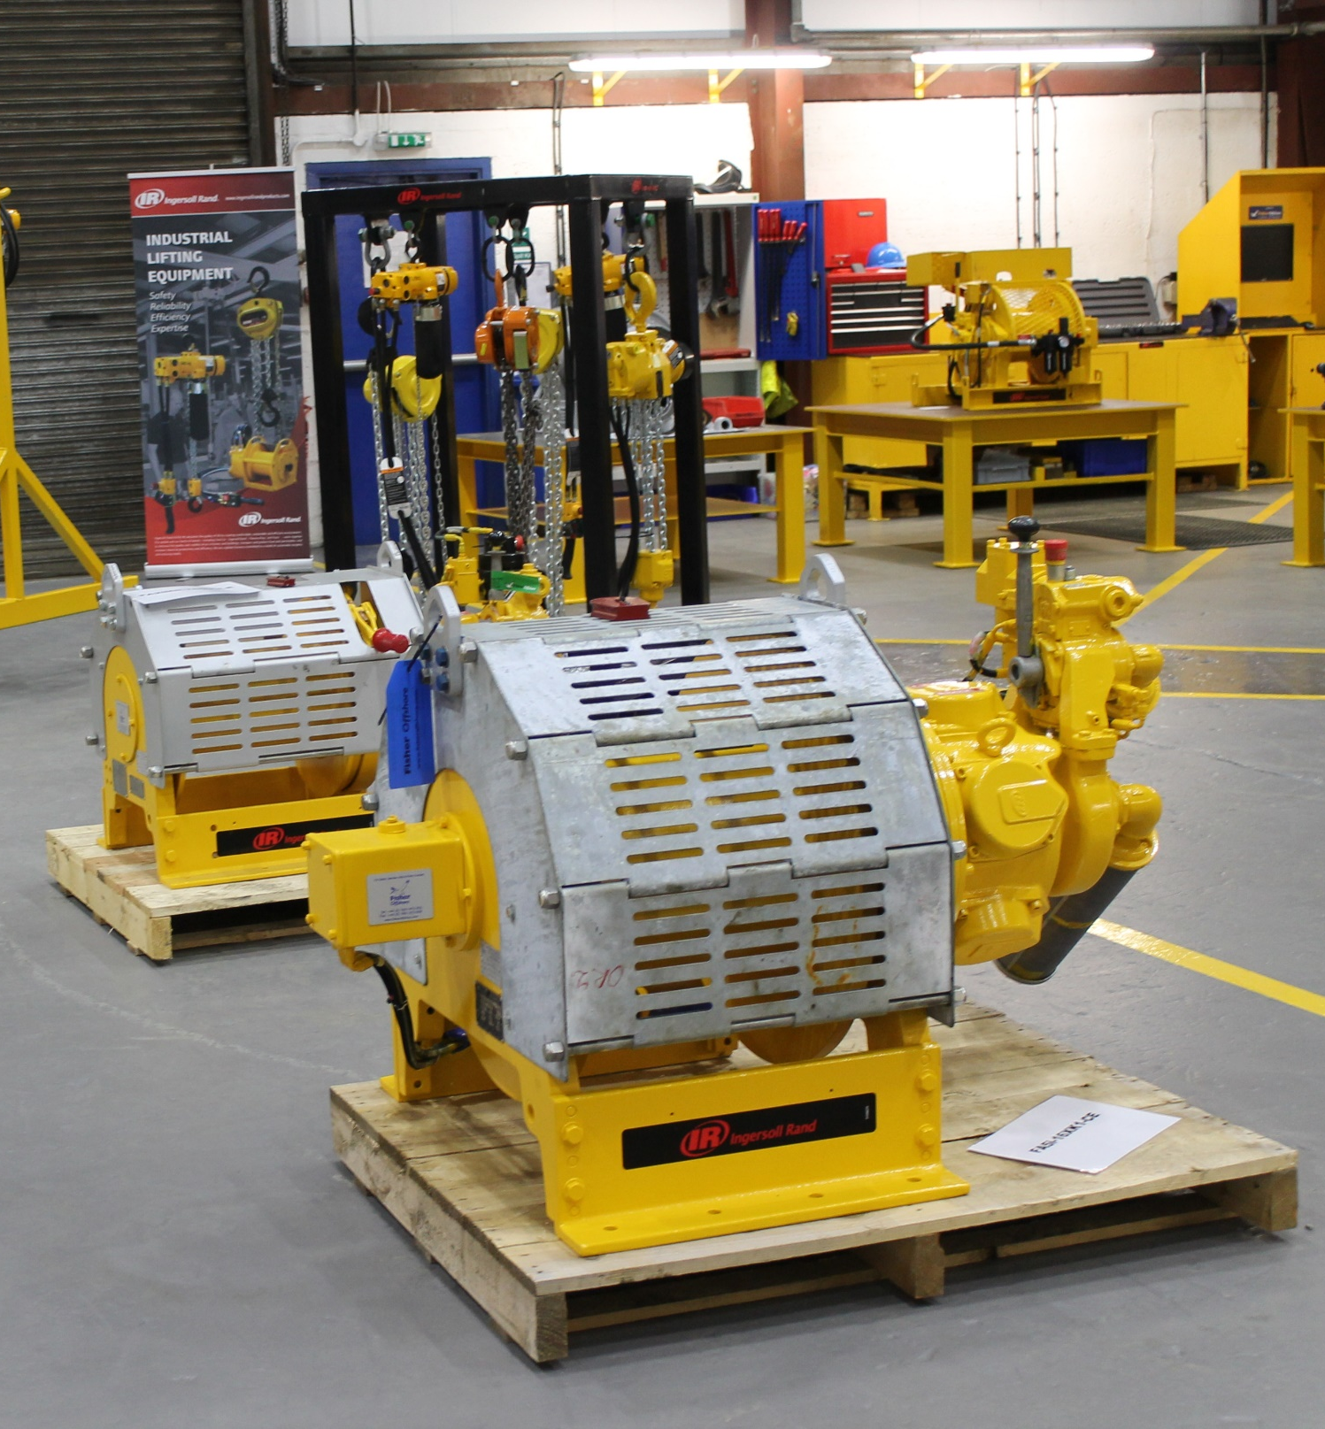
DRI is specialised in the field of lifting and Starters and offers its customers a wide range of equipment as well as maintenance and on-site installations.
Our competence and expertise make us a valued partner.
All of our accessories and options are tailored specifically to the customer’s request, as ATEX standards for example.
DRI also provide a quality service of installation and repair of air starter backed by a highly qualified team of engineers
LARGE STOCK
PRODUCT MAN
SERVICE CERTIFIED BY
Ingersoll-Rand

Slide 3
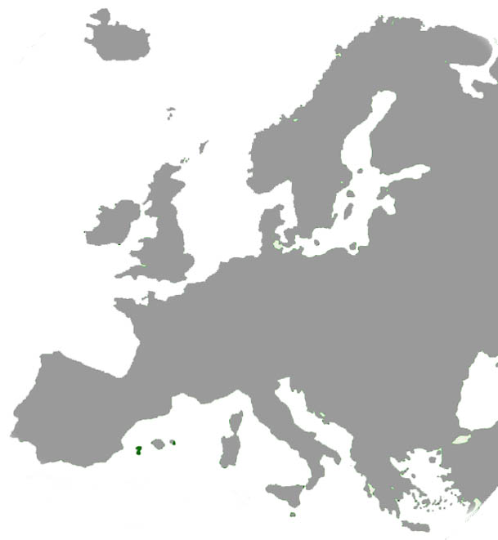
DRI have signed an agency agreement with James Fisher Offshore (JFO) to work in partnership throughout Europe
James Fisher Offshore is a specialist offshore partner, delivering fully integrated subsea solutions across the full life cycle of offshore projects.
JFO HQ
With our product portfolios aligned we can provide our clients in France easy access to the JFO extensive rental fleet, backed up with the local support of the DRI team.
DRI HQ

Slide 4
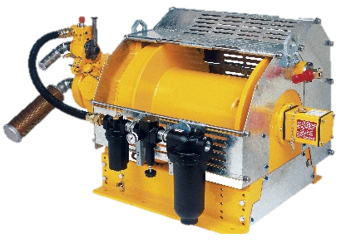
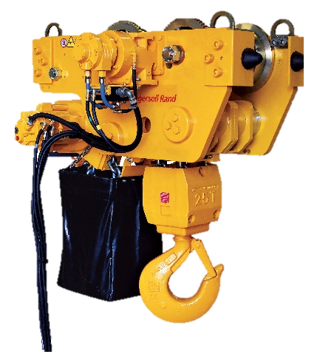
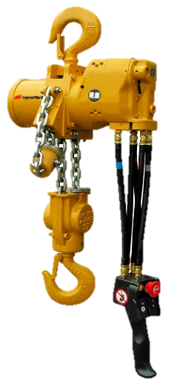
DRI-France: Drilling Support
DRI specialises in lifting/handling and is the sole distributor for all Ingersoll Rand material handling products for France.
- Air or Hyd. Hoists for BOP Handling Applications
- Air or Hyd. Winches for Man Riding Applications
- Utility Lifting applications on the drill floor
- Portable winches for Monkey board applications
- Winches for Guideline/Pod-line Applications

Slide 5
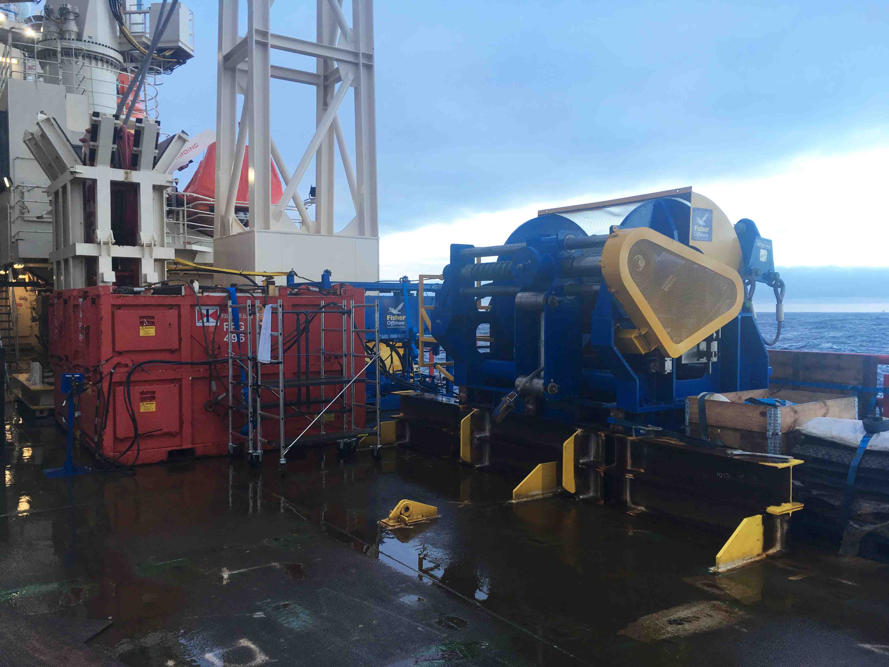
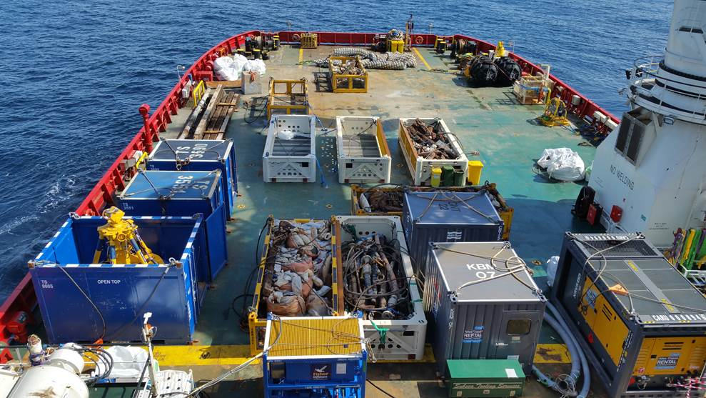
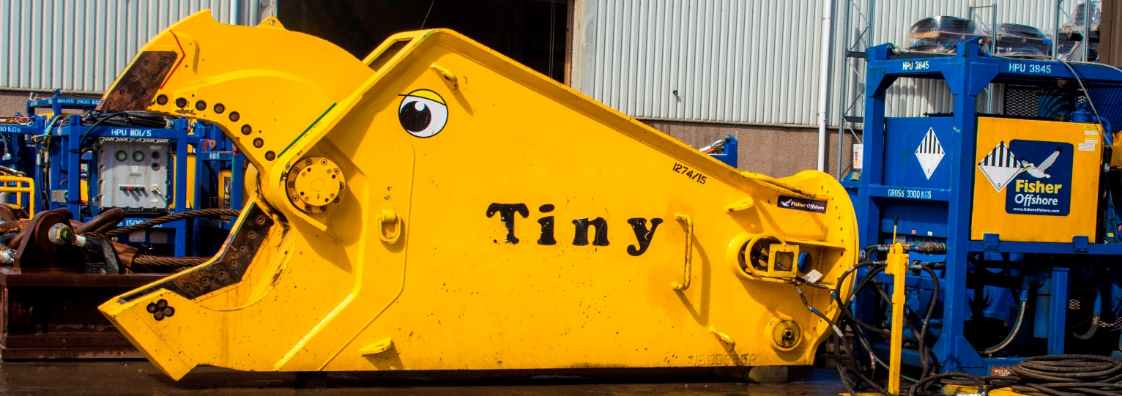
JFO: Construction
JFO is a market leader in the provision of equipment and services to support subsea, topside and shore pull infrastructure installation campaigns. We have a proven track record in the delivery of subsea tiebacks, caisson lifts, umbilical and riser pull-ins
JFO: IRM
JFO is an expert in full back deck service provision and our experience enables us to deliver multi-vessel and multi-campaign scopes of work. We have extensive experience in cutting, recovery and removal campaigns
JFO: Decommissioning
JFO offers complete service capability in the dredging, cutting and removal of subsea and platform infrastructure.

Slide 6
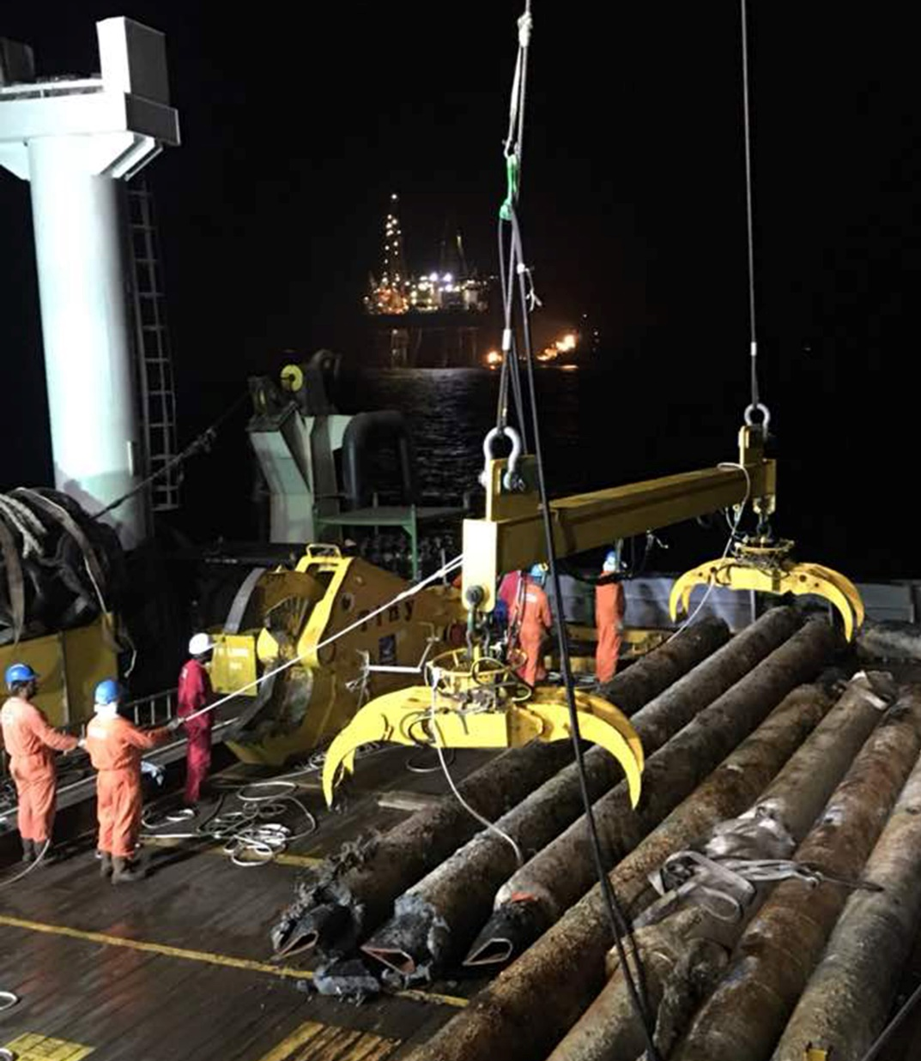
Decommissioning
Fully embedded partner in the methodology and execution of our clients decommissioning campaigns
Complete service capability in the dredging,
cutting and removal of subsea and platform infrastructure
Recognised leaders in:
Pipeline and bundle cutting
Conductor/wellhead cut and lift - ICLT®

Slide 7
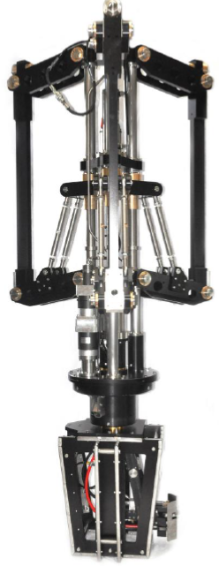
Internal Cut and Lift Tool
Offering cost efficiencies through smarter
subsea structure cutting and removal:
One cut and lift operation
One multi purpose spread
One mobilisation
One multi-disciplined crew

Slide 8
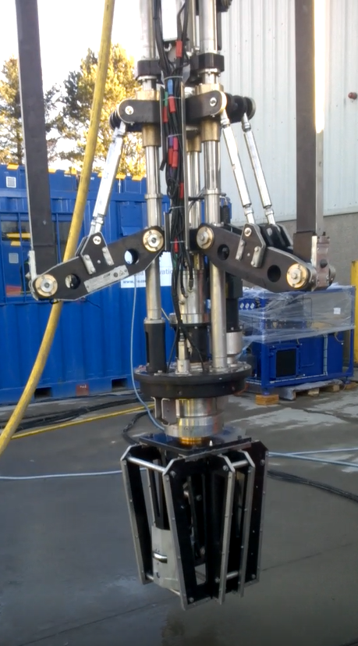
Internal cutting system
Live 360° cut verification – No stitching
Pressure induced garnet cutting
Cutting system locked in situ for cut stability
Suitable in water depths up to 350mtr
Can cut up to 500mm of multistring casing

Slide 9
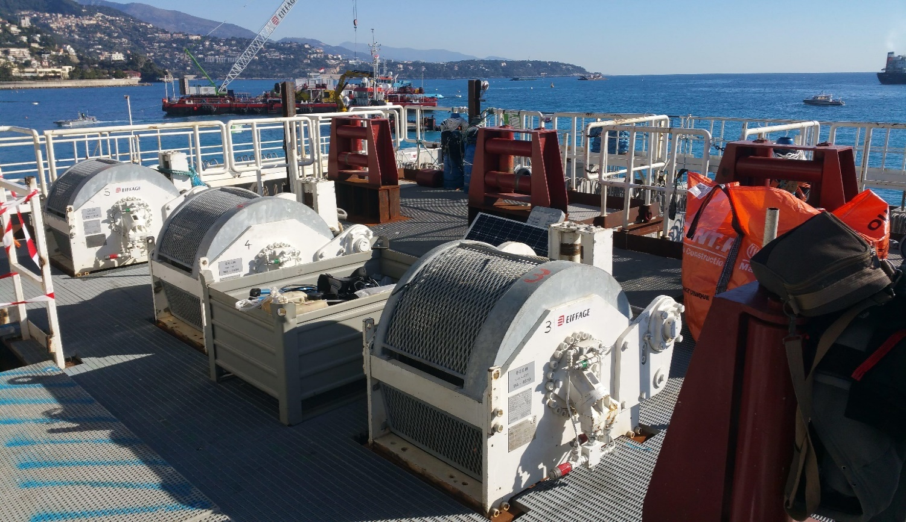
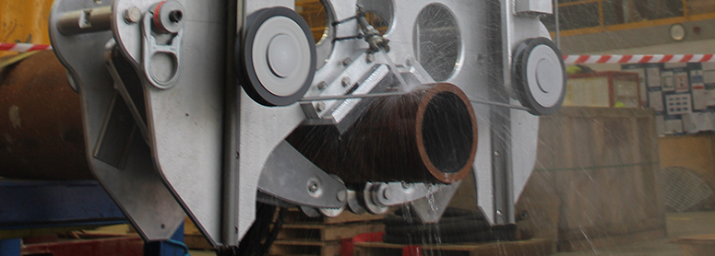
JFO and DRI have worked together on several projects throughout Europe and West Africa
Port development Monaco
Winches for mooring and positioning for land reclamation
12 x 15Te hydraulic winches
2 x HPU
Baobab, Ivory Coast
Upgrade of subsea spools
1 x Diamond Wire Saw
1 x Subsea Basket

Slide 10
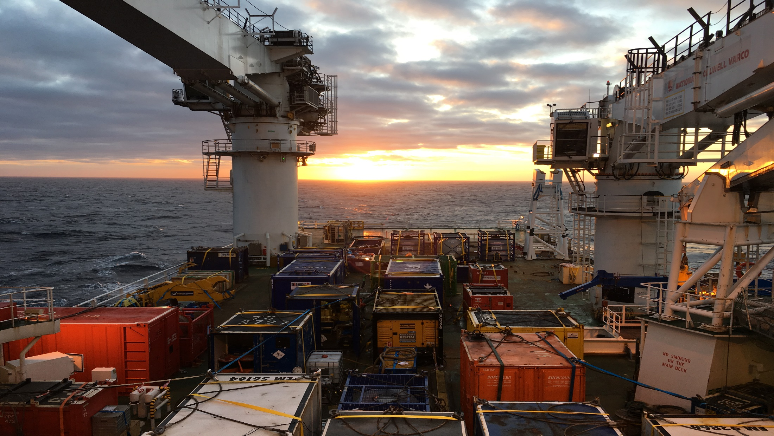
Multi purpose spread
Internal Cut and Lift Tool
A Frame/Overboard chute
Hose Reeler/Umbilical
Air Compressor
Abrasive Mixing Unit
Control system and HPU
Ultra High Pressure Pump
Workshop Container
Abrasive garnet

Slide 11
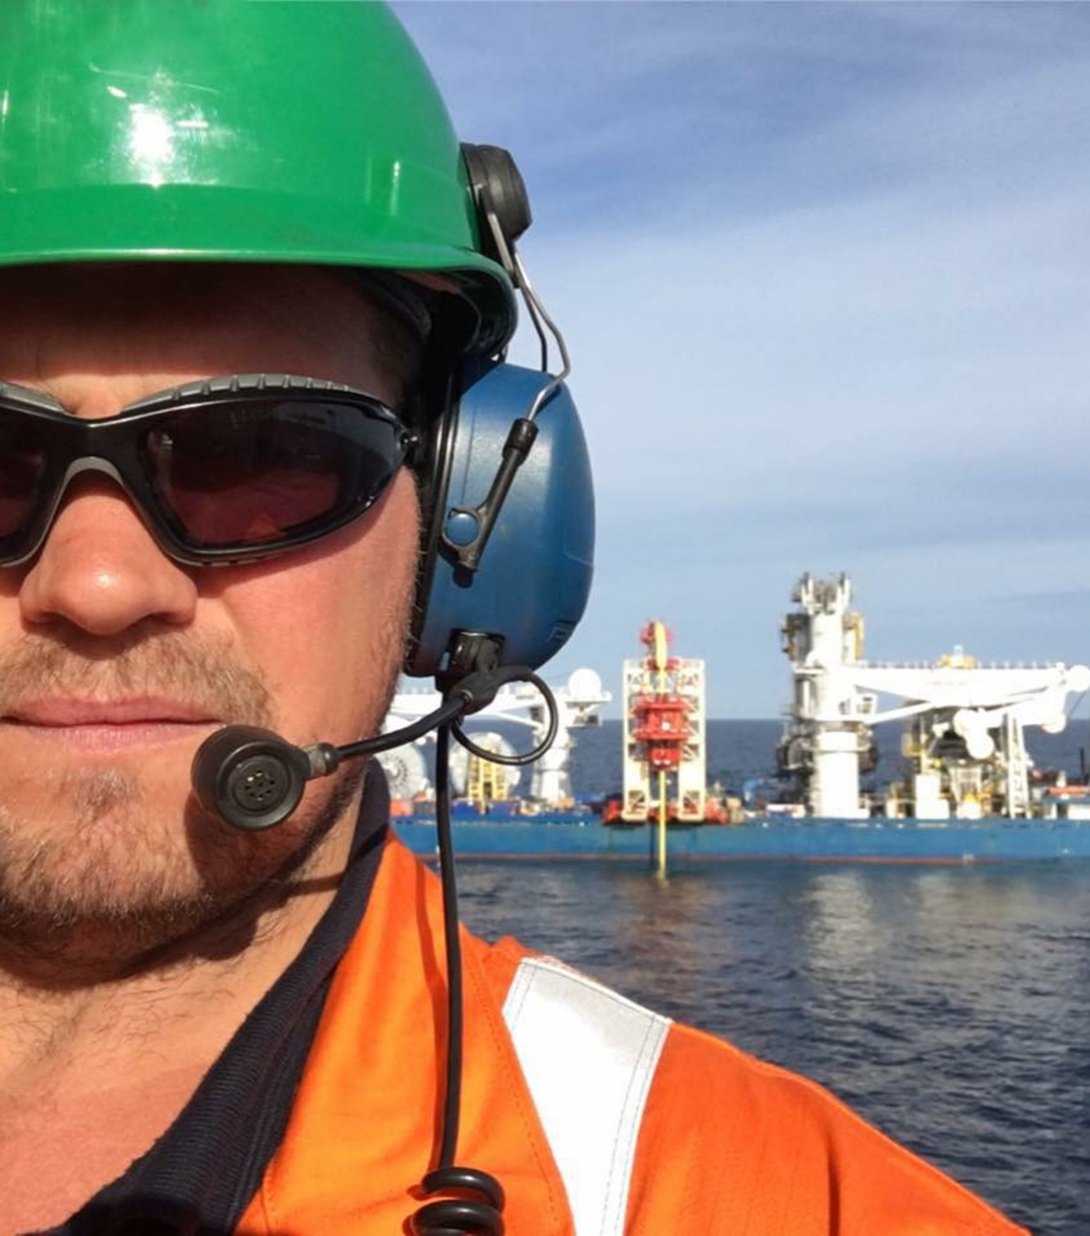
People
In-house engineering and expertise offering our clients global support
Highly skilled and certified offshore supervisors, technicians and operators
Multi-trained and experienced technicians
providing valued integration to our clients
existing crews

Slide 12
We employ over 3000 people across 40 countries worldwide
Agotnes
Stavanger
Vaxholm
UK
Gravelines (DRI)
Norfolk
Houston
Al Khobar
Doha
UAE
Shenzen
Ciudad del Carmen
New Delhi
Maracaibo
Lagos
Accra
Kuala Lumpur
Singapore
Jakarta
Luanda
Rio de Janeiro
Maputo
Santa Cruz
Namibia
Perth
Durban

Slide 13
CONTACT US
Chris REID
Tel : +44 (0) 7585 110 748
Mail : c.reid@fisheroffshore.com
Website : www.fisheroffshore.com
Pascal VILLAIN
Tel : 03.28.63.92.21 / 06.32.54.01.46
Mail : pascal.villain@dri-france.com
Website : www.dri-france.com

